Slide 1
Analyzing H5N1 and H7N9 Influenza Reported Cases
Nirbhay Pherwani
https://nirbhay.me

Slide 2
Introduction
There have been a number of cases reported for avian influenza A(H5N1) and A(H7N9) which has infected large number of bird and human species in recent years.
There have been some devastating effects seen in those infected too.

Slide 3
Introduction
According to an article on Healio^{[3]}, “The mortality rate in documented cases is high for both strains of avian influenza, about 60% for H5N1 and about 30% for H7N9”
These viruses have remained endemic especially in China and globally for over two decades.

Slide 4
Problem Statement
Analyze the regions of impact of H7N9 outbreaks in China.
Learn from that analysis, apply it and highlight potential areas of impact for H5N1 outbreaks.
Which will further help in forming policies and allocating resources in case of major outbreaks and pandemics.

Slide 5
Motivation
To be prepared in case of major outbreaks / pandemics caused by H5N1 cases.
According to WHO, “H5N1 infection in humans can cause severe disease and has a high mortality rate. If the H5N1 virus were to change and become easily transmissible from person to person while retaining its capacity to cause severe disease, the consequences for public health could be very serious”

Slide 6
Project Goals & Objectives
Help with policy making and resource allocation.
Doing an extensive analysis to investigate the major factors contributing to a region being a potential outbreak site.
Involving other parameters and analyzing patterns of globalization and increased travel and trade to help limit impact at origin of outbreak.

Slide 7
Project Goals & Objectives
Specific to this analysis: Highlight potential areas of impact for H5N1 outbreaks.
Objective 1 - Present past data relating to both kinds of influenza cases, A(H7N9) and A(H5N1)
Objective 2 - Use ArcGIS as a visual representation tool for showcasing analysis done on A(H7N9) for China and then A(H1N5) for other regions. (for eg: Nigeria)

Slide 8
Literature Review
Spatial Distribution Characteristics of A(H7N9) Human Infections in China Between 2013 and 2014.^{[1]}
Performed clustering and outlier analysis for influenza cases in 2013, 2014 to find three prominent regions.
Also did hotspot analysis to cross check and found out that results were consistent.
Determined that using GIS can be useful in controlling future epidemics and also in identifying high-risk areas.

Slide 9
Literature Review
Priority areas for surveillance and prevention of avian influenza during the water-bird migration season in Pakistan.^{[2]}
Migrated birds from Pakistan may be one of the reasons.
Used Asian waterbird census data.
64% of outbreaks of A(H1N5) occurred during migration.
(Bird Migration) - A point to further investigate.

Slide 10
Methods
ArcGIS
Avian Influenza Cases Data
Cluster and Outlier Analysis
Hotspot Analysis

Slide 11
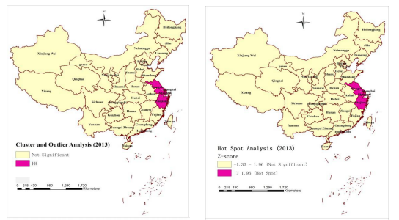
Expected Results
Image sourced from literature reviewed.

Slide 12
References
[1] Dong, W. (2018). Spatial Distribution Characteristics of A(H7N9) Human Infections in China Between 2013 and 2014. Proceedings of the 3rd International Conference on Intelligent Information Processing - ICIIP 18. doi: 10.1145/3232116.3232675.
[2] Abbas, T., Wilking, H., Staubach, C., Ziller, M., & Conraths, F. J. (2011). Priority areas for surveillance and prevention of avian influenza during the water-bird migration season in Pakistan. Geospatial Health, 6(1), 107. doi: 10.4081/gh.2011.162

Slide 13
References (Contd.)
[3] Kaye. (n.d.). Avian influenza: A comparison of A(H5N1) and A(H7N9). Retrieved from https://www.healio.com/infectious-disease/news/print/infectious-disease-news/{bfb26f60-bf2a-4db7-9359-b6ba04dc4c4f}/avian-influenza-a-comparison-of-ah5n1-and-ah7n9.
[4] FAQs: H5N1 influenza. (2012, March 28). Retrieved from https://www.who.int/influenza/human_animal_interface/avian_influenza/h5n1_research/faqs/en/.

